Slide 1




MOVIE
DATA
ANALYSIS
A035 – Kartik Lakhotiya A036 – Mitej Madan
A037- Diya Maheshwari

Slide 2

INTRODUCTION
TMDb is a large online database for film and TV information.
Founded in 2008, it allows anyone to contribute data on actors, directors, and more.
Starting as a movie poster sharing community, it now boasts over 543,000 movies and 92,000 TV shows.
With a large and active community, TMDb is a popular resource for media centers.

Slide 3

GOALS AND EXPECTATIONS
Film making is risky despite high budgets, predicting success is crucial.
Experience and fame (directors, actors) are important but don't guarantee audience approval.
This project aims to analyze TMDB 5000 movie data to identify factors influencing success (revenue & score).
By applying data science techniques, the goal is to uncover what makes a blockbuster film.

Slide 4



DATA ANALYSIS

Slide 5
DESCRIPTION OF DATA
The TMDB movie dataset consists of 5,000 films with details split across two CSV files:
tmdb_5000_movies.csv: Contains film information like title, genre, revenue, and more (17 qualitative & 7 quantitative variables).
Qualitative (descriptive): title, genre, language, etc.
Quantitative (numerical):
Discrete: votes, release date, runtime
Continuous: revenue, budget, popularity, average vote
tmdb_5000_credits.csv: Provides cast & crew details (references movies in the first file using title & ID).

Slide 6
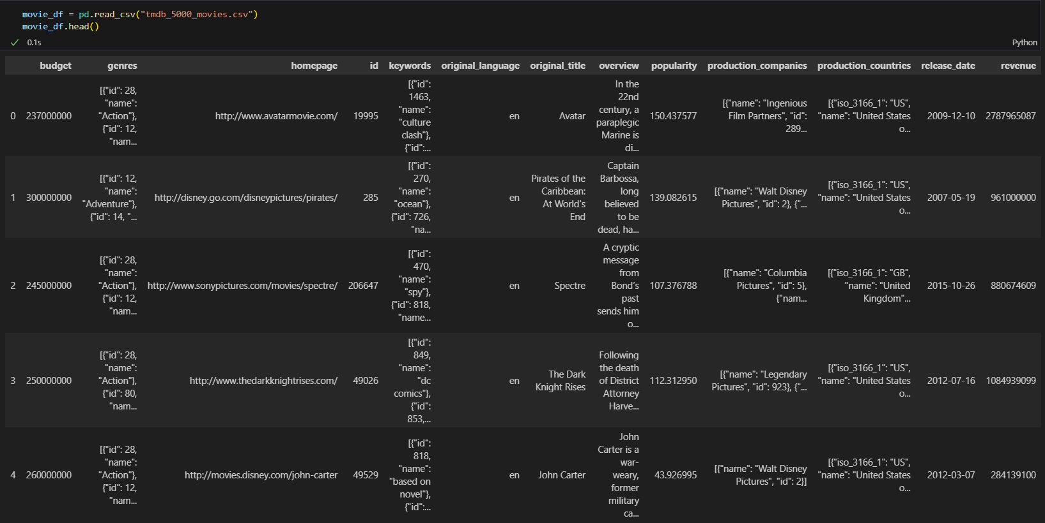

Slide 7
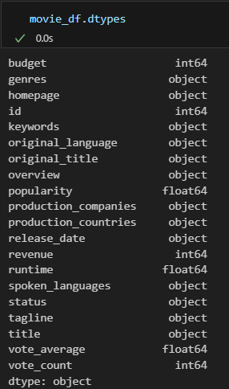
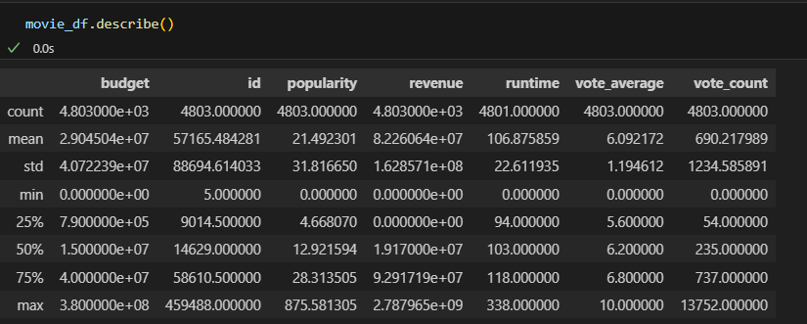
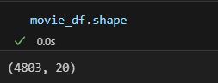
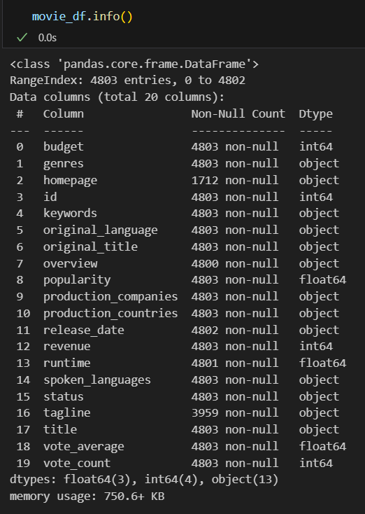

Slide 8
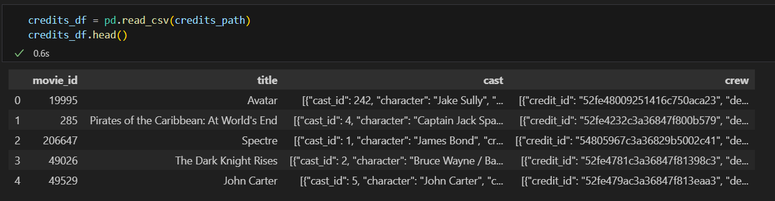
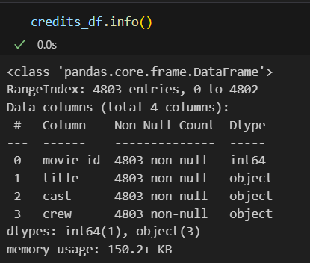
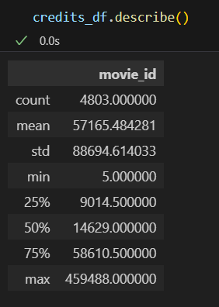
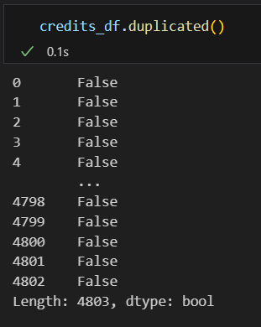

Slide 9
DATA CLEANING
Dataset issues: JSON format in some columns, missing values, zero values, duplicate titles, and release date format.
JSON addressed: Converted to Python dictionaries using json.loads().
Missing values handled: Home page and tagline dropped, null overview replaced with "unspecified", release date dropped, runtime nulls replaced with average.
Zero values handled: Revenue and budget under $1,000 dropped, other zero values dropped.
Duplicate titles fixed: Titles made unique by adding release year.
Release date reformatted: Split year, month, day into separate columns.

Slide 10
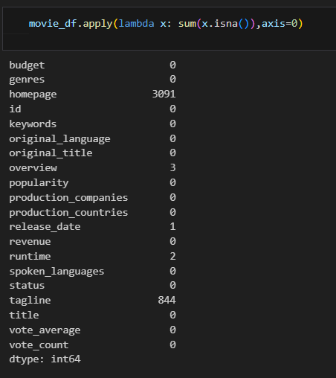
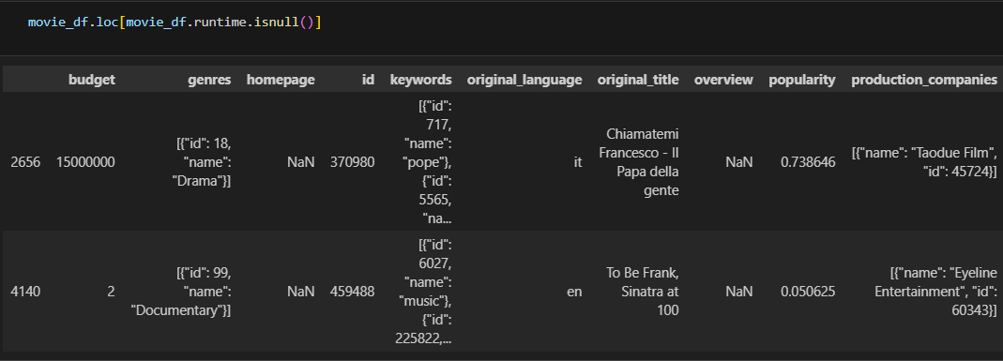
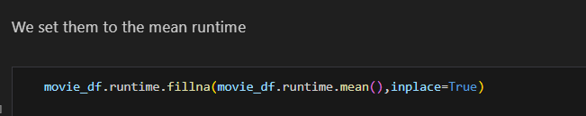

Slide 11
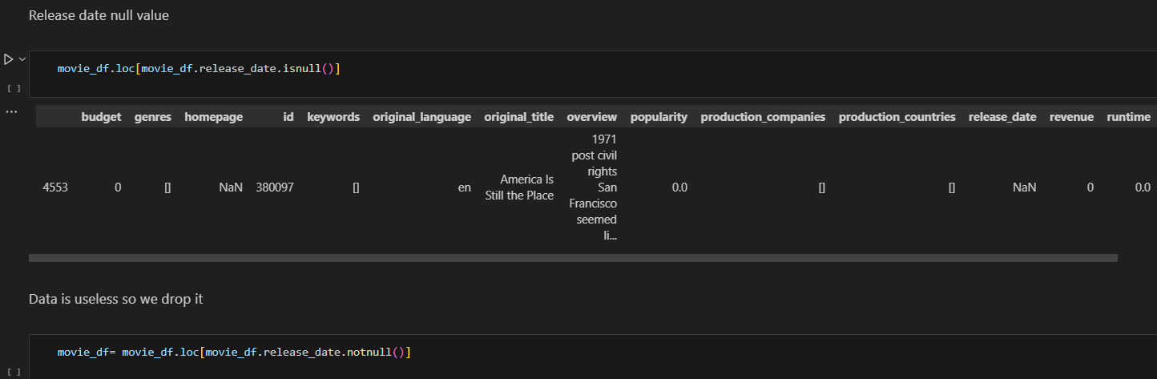
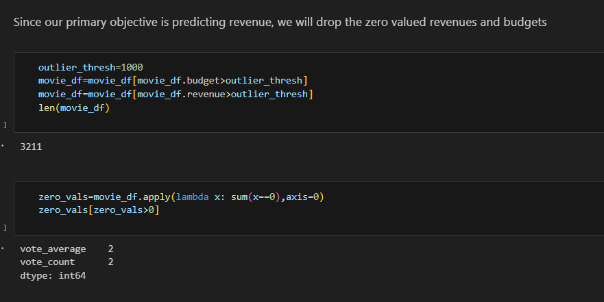

Slide 12
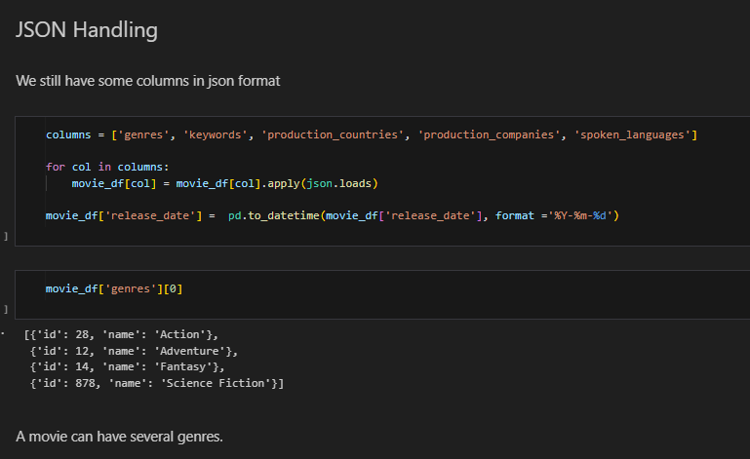
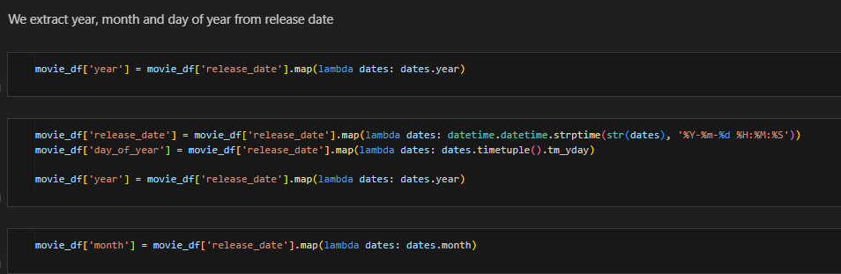

Slide 13
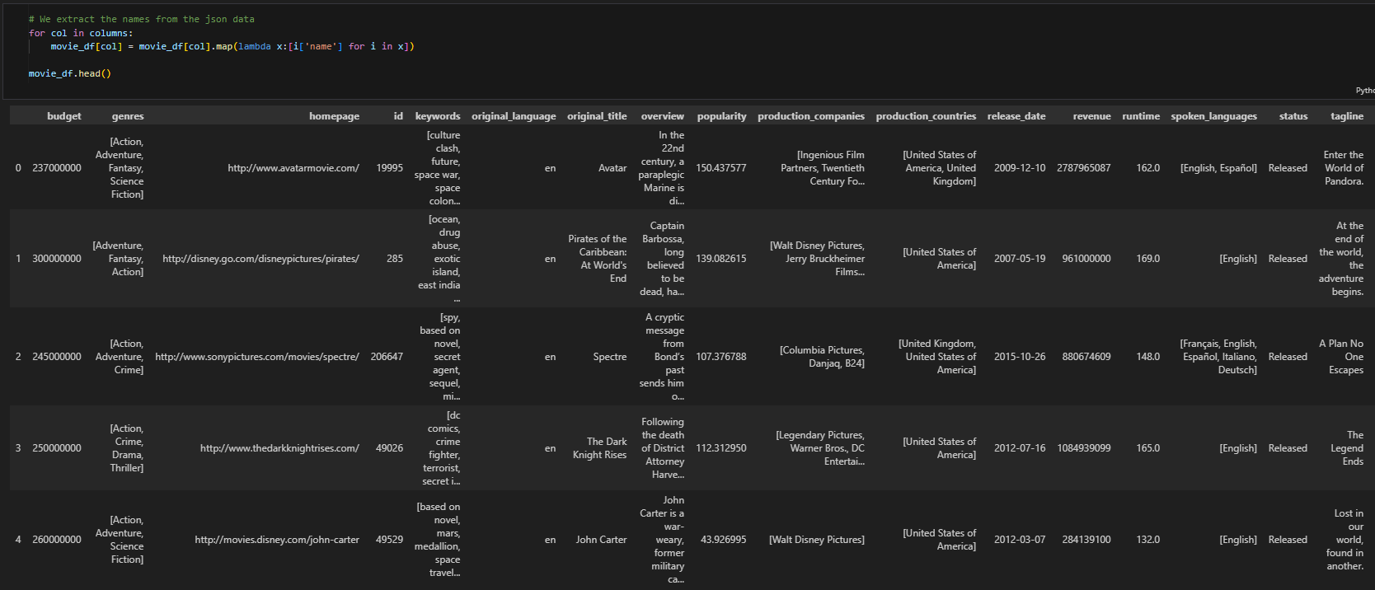

Slide 14

EXPLORATORY DATA ANALYSIS
(EDA)

Slide 15
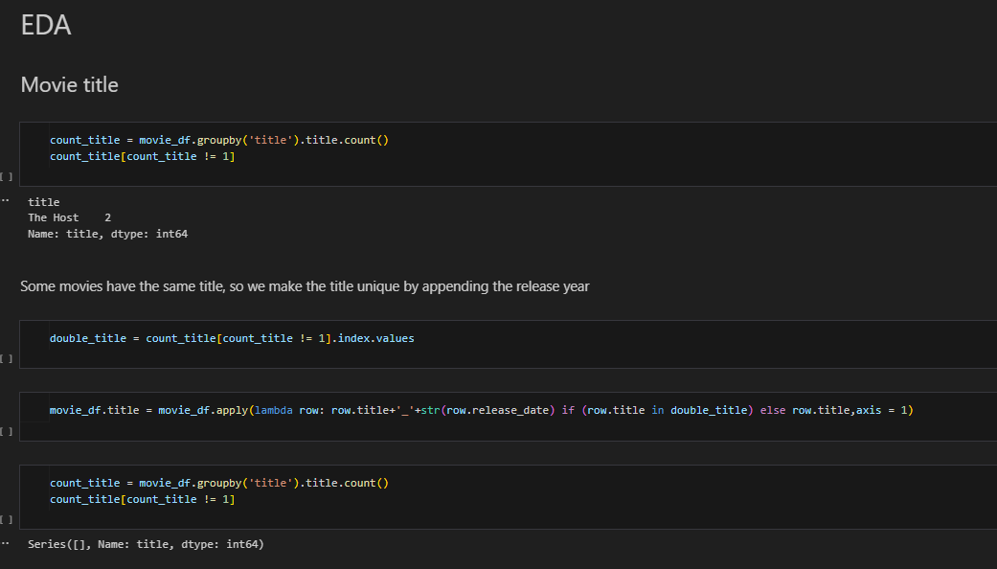

Slide 16
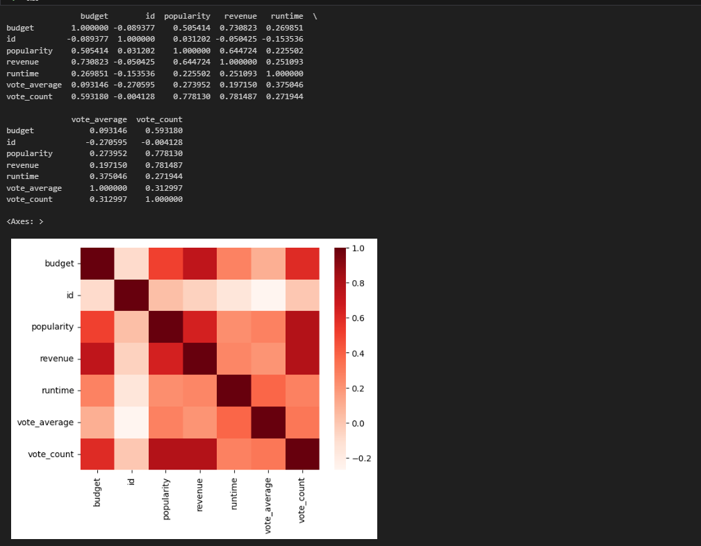
CORRELATION MATRIX

Slide 17
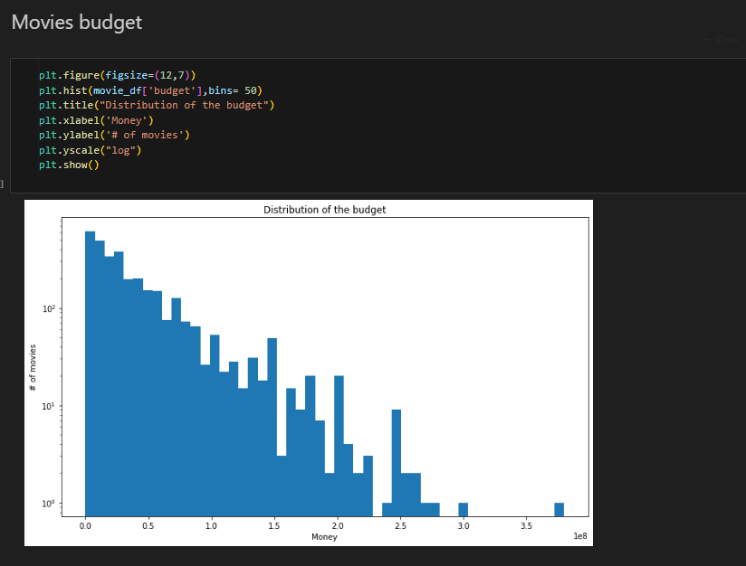
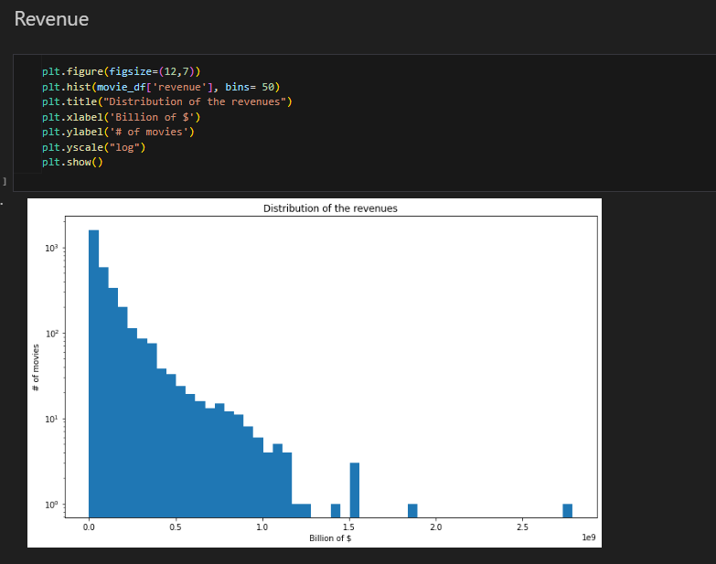

Slide 18
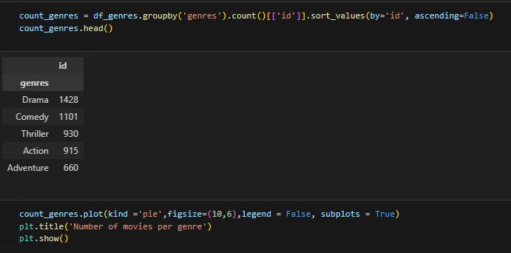
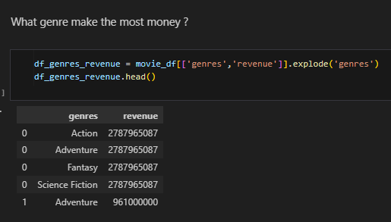
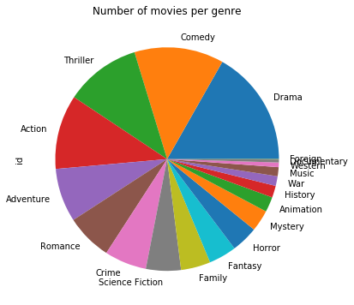

Slide 19
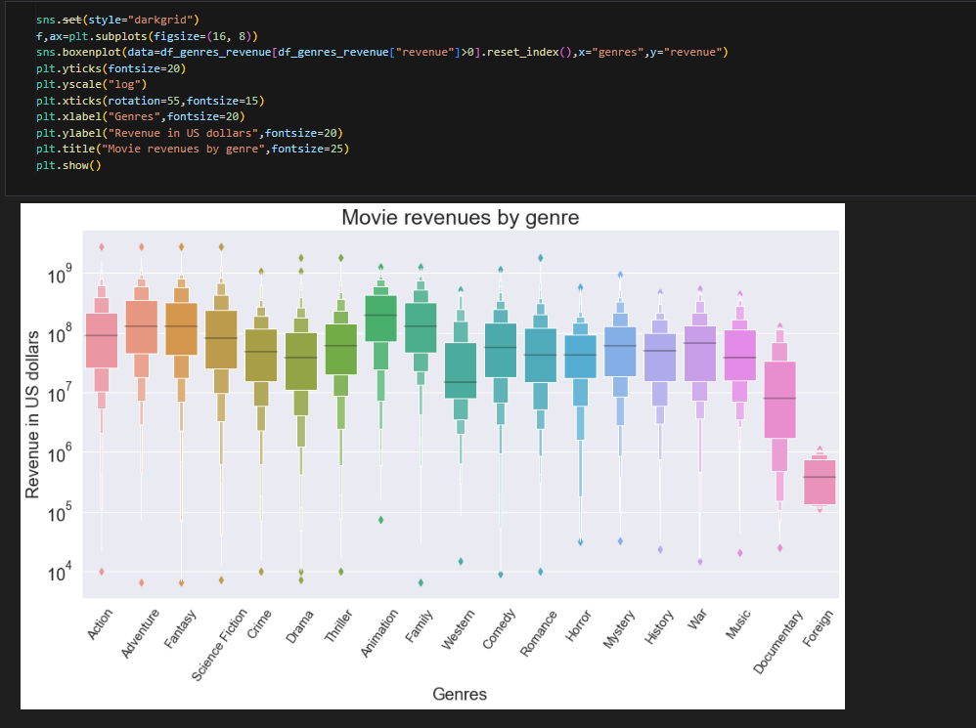

Slide 20
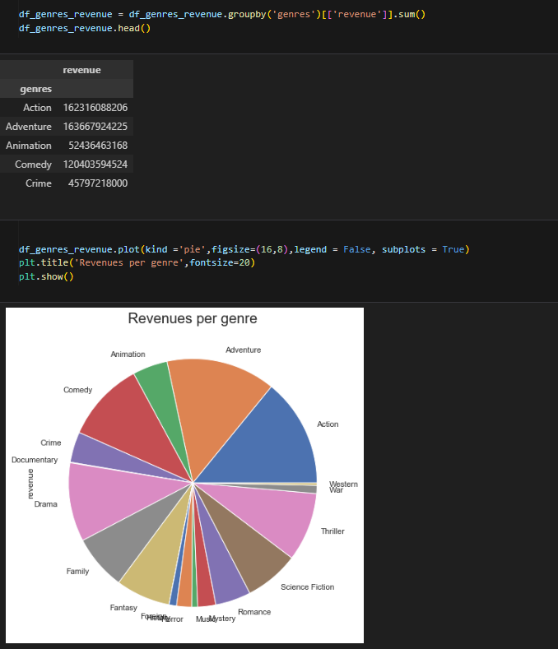

Slide 21
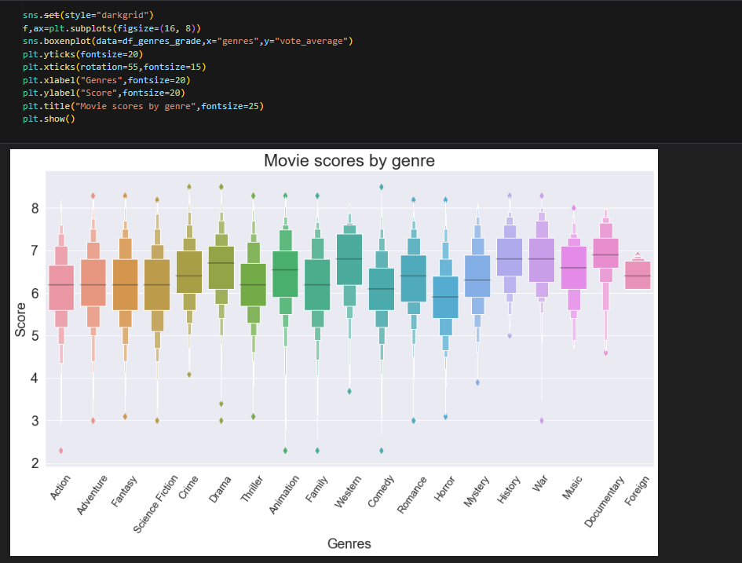

Slide 22
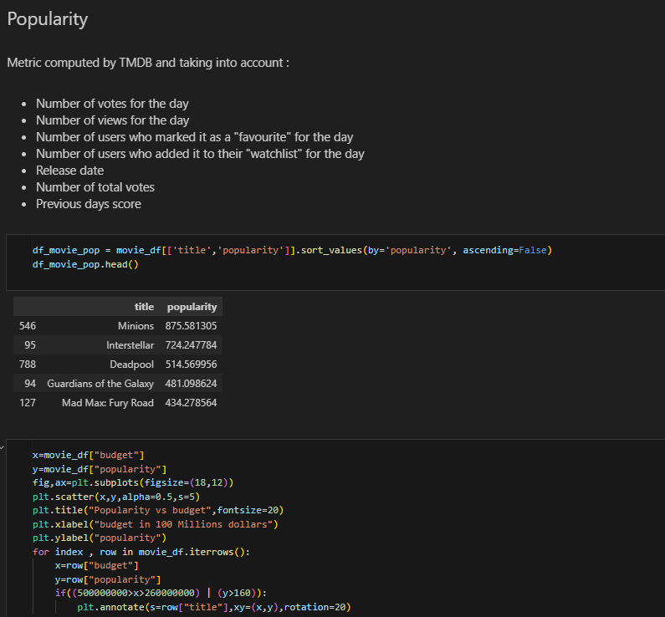

Slide 23
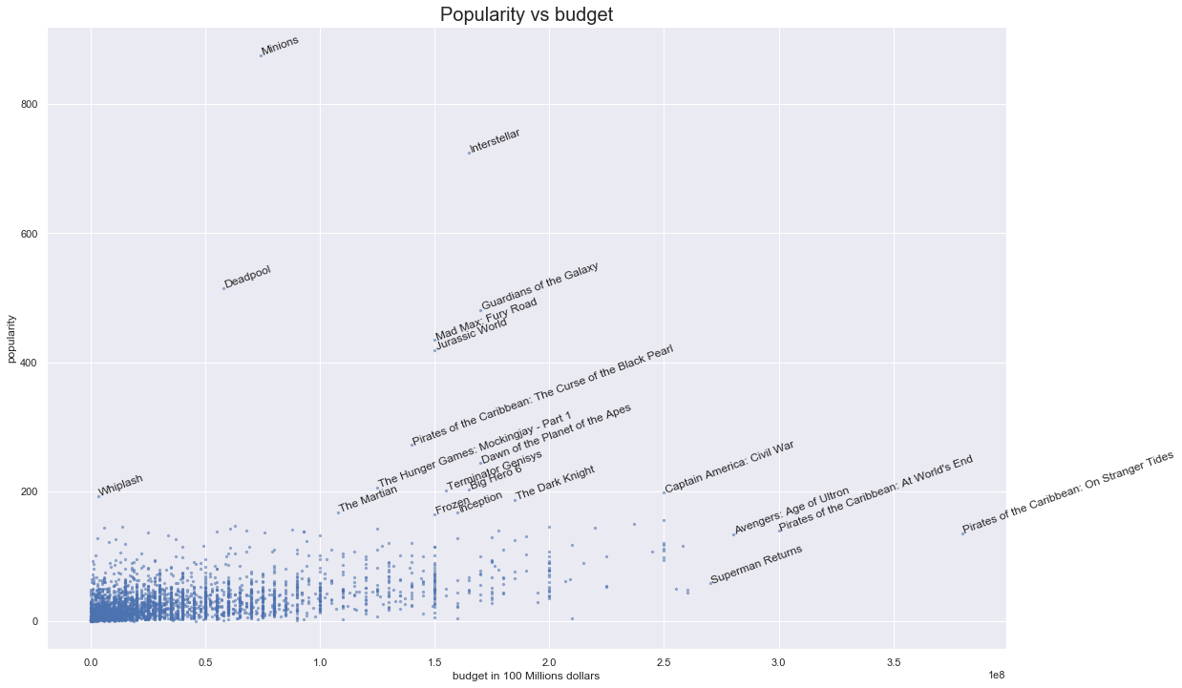

Slide 24
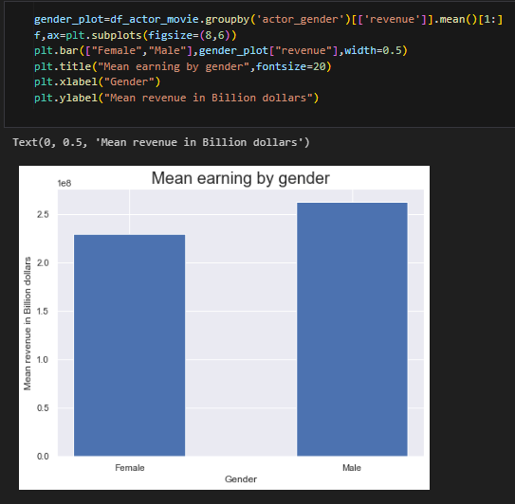
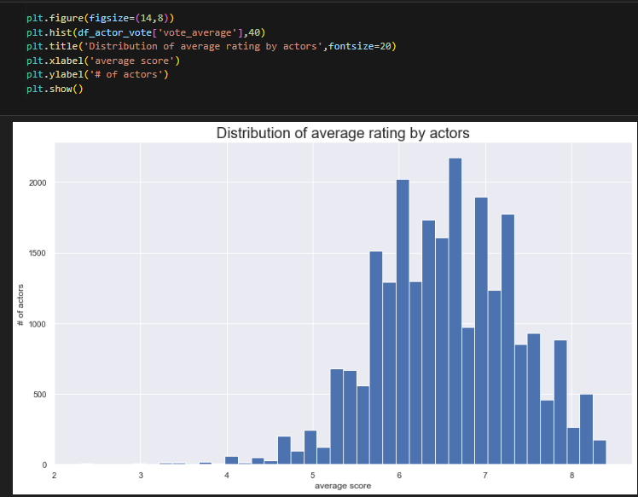

Slide 25
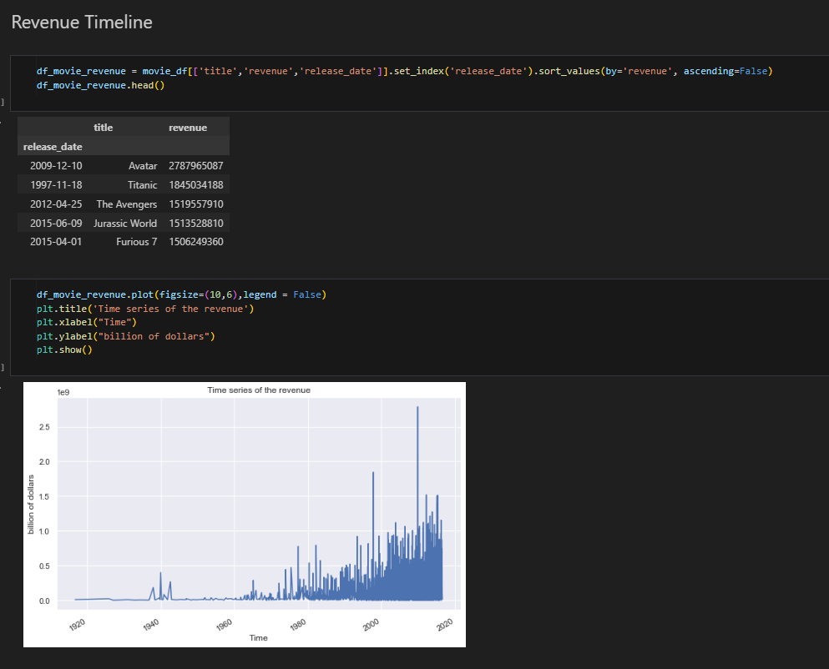

Slide 26
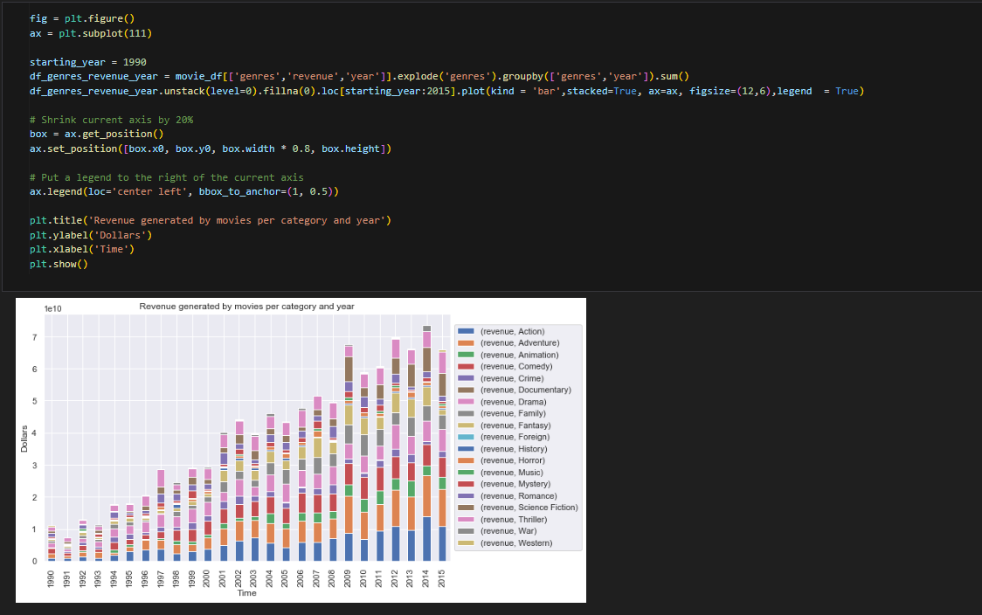

Slide 27
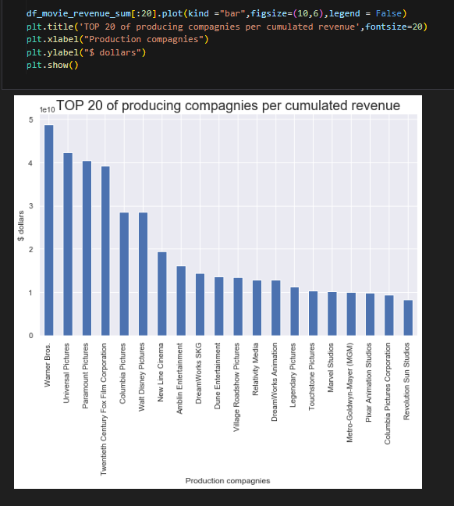
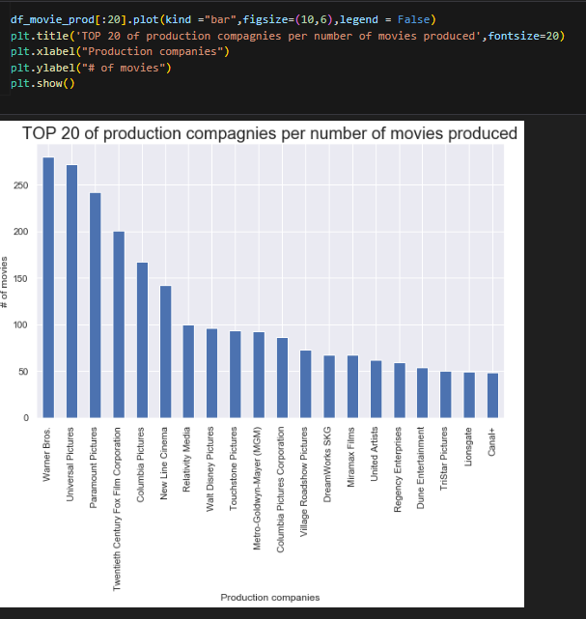

Slide 28

CONCLUSION
1. Data Exploration and Cleaning: We delved into the TMDb movies dataset, initially encountering raw and unprocessed data. Through meticulous data cleaning and exploratory analysis, we uncovered insights into various aspects of movie production and success.
2. Visualization and Analysis: By visualizing relationships between movie characteristics and success metrics, such as revenue and popularity, we gained valuable insights into what defines a successful movie. For example, we scrutinized the significance of budget and quantified its impact using statistical metrics.
3. Future Implications: Our project underscores the potential of data analysis and data science in revolutionizing the film industry. As we strive to improve predictive capabilities, we envision a future where the film industry increasingly relies on data-driven insights to enhance competitiveness and elevate the standards of film production.

Slide 29

THANK
YOU!

